Slide 1


Slide 2
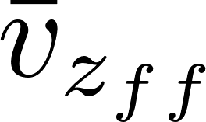
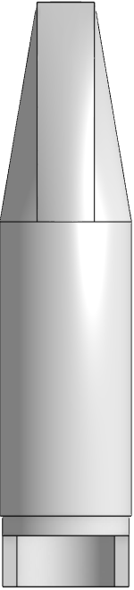
Effluent manifold
Plate Settlers
Floc Filter
Floc Hopper
Inlet (from flocculator)
Notes:
Story
Big green flocs from flocculator form blue floc filters in the plate settler
Red flocs

Slide 3
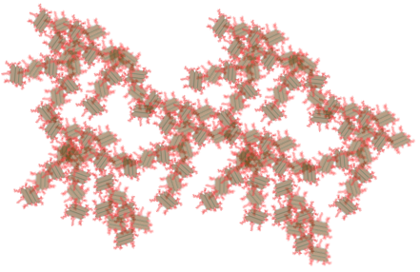
I’m stuffed (my fractal dimension is too big and my porosity is too small)
I’m getting full

